Slide 1
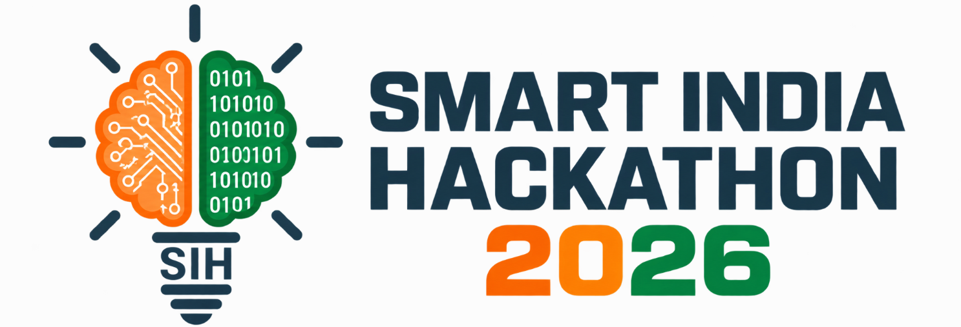

SMART INDIA HACKATHON 2026
Problem Statement ID - SIH26044
Problem Statement Title - Portal for Academia- Industry Collaboration for Skill Mapping, Internships and Placements
Theme - Smart Automation
PS Category - Software
Team ID -
Team Name- Mindmesh

Slide 2


Mindmesh
OUR IDEA
A unified platform connecting Students, Colleges and Industry
through skill-based matching.
Proposed Solution
Our Solution & Target Audience
HOW IT WORKS ?
One Platform Connecting Three Stakeholders
Build Student Profile Students add their skills, projects, interests and academic details.
Skill Analysis The platform analyses student capabilities and identifies relevant skill areas.
Match Requirements Industry requirements are compared with student skill profiles.
Recommend Opportunities Relevant internships, projects and jobs are suggested.
Track & Improve Students can track applications and outcomes while colleges monitor overall progress.
Students: Profiles, skills, resumes, opportunities, and applications.
Companies / AYUSH Partners: Post internships/jobs and find candidates
Colleges / Admin: Monitor applications, placements, and skill trends.
Skill-based matching connects student capabilities with industry requirements.
Student Profile → Skill Analysis → Smart Matching → Opportunity → Outcome

Slide 3

TECHNICAL APPROACH
Mindmesh
Technology to be Used
STUDENT INDUSTRY
──────── ─────────
Python Python ✓
Flask Flask ✓
SQL SQL ✓
UI Design UI/UX ✓
Cloud ✗
↓ ↓
MATCH ANALYSIS
↓
MATCH SCORE
80%
↓
Recommended Opportunity
Core Technical Stack & Architecture
Frontend Layer
HTML, CSS, JavaScript
Backend Framework
Python(FLASK AND SQL ALCHEMY)
Database Layer
SQLite Database
Web browser accessible, lightweight, and deployment-ready framework.
SMART MATCHING → BETTER SKILLS → BETTER OPPORTUNITIES

Slide 4

FEASIBILITY AND VIABILITY
Mindmesh
“Built for rapid campus adoption, scalable deployment, and long-term industry collaboration.”
Feasibility Highlights
Viability & Growth
Rapid Development: Built using standardized, open-source web technologies minimizing cost and setup friction.
High Scalability: Modular design allows straightforward database migration.
Low Resource Footprint: Runs smoothly on existing campus infrastructure without expensive hardware prerequisites.
Institutional Ready: Easily adaptable by colleges nationwide with minimal onboarding effort.
Low Maintenance: Simple architecture allows fast updates, bug fixes, and security patches.
Future Expandability: Ready for AI recommendation engines and automated resume scoring integrations.
1 College → 10 Colleges → Multi-Campus → 🇮🇳 Nationwide

Slide 5
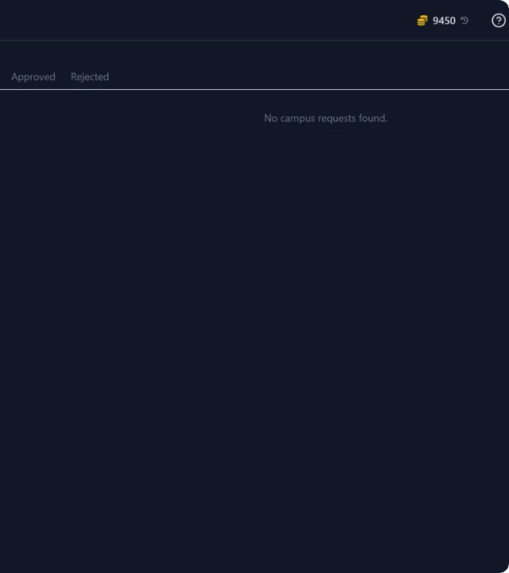
IMPACT AND BENEFITS
Mindmesh
OVERVIEW
Social Impact: Fosters direct interaction between students, academia, and industry leaders. Empowers students with real-world exposure and practical learning.
Economic Efficiency: Drastically reduces search time for internships, slashes talent acquisition costs for AYUSH enterprises, and improves graduate placement rates.
Ecosystem Growth: Strengthens India's AYUSH ecosystem through structured skill development and standardized industry-academia partnerships.
STUDENT DISCOVERS ↓ SKILL GAP IDENTIFIED ↓ RIGHT OPPORTUNITY MATCHED ↓ REAL-WORLD EXPOSURE ↓ CAREER-READY TALENT

Slide 6
RESEARCH AND REFERENCES
Mindmesh
Ministry of Ayush, Govt. of India: Aligned with the national initiative to digitize, modernize, and promote skilled workforce development across traditional healthcare sectors.
https://ayush.gov.in/
Smart India Hackathon 2026: Directly addresses Problem Statement ID SIH26044 under the Smart Automation software category.
https://www.sih.gov.in/
NITI Aayog Framework: Supports national policy goals focusing on industry-relevant education, skill mapping, and enhancing youth employability.
https://www.niti.gov.in/about-us/objectives-and-features
TIME FOR A DEMO!!!

